Slide 1
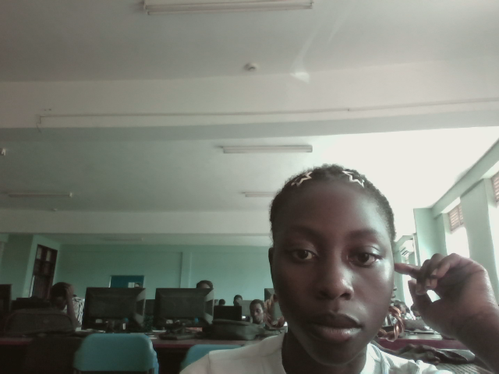
DATABASE SYSTEMS PROJECT
GROUP PROJERCT LIBRARY DATABASE
AREA CHOSEN CIRCULATION SYSTEM
Prepared By: Agatha
Course Unit: Database Management Systems
lecturer: Baguma Kenneth
Date: 4thMay 2026

Slide 2

The library circulation system
A Library Circulation System is a database system that manages the borrowing and returning of books and keeps records of library members and library materials

Slide 3
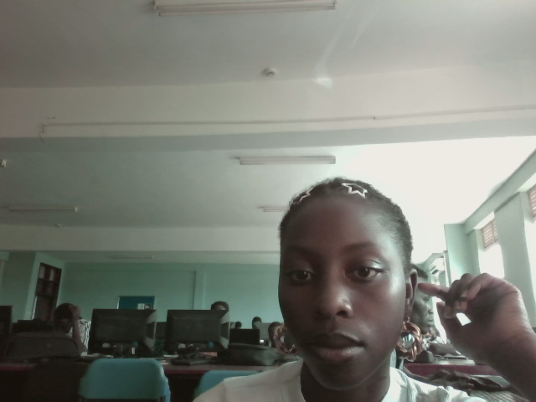
PROJECT OBJECTIVES
The Main Objective is to design and implement a library circulation database system which:
To store member information.
To manage book records.
To track borrowed and returned books.

Slide 4
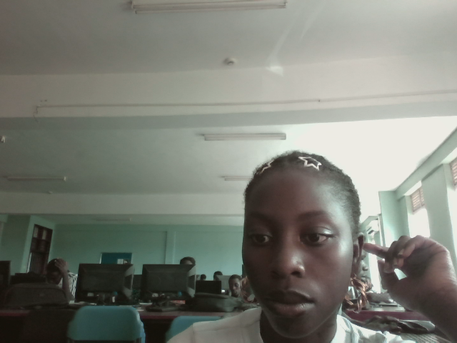
Major importance and problem solved
managing records manually can lead to loss of information , errors and delays , so the circulation system solves this by automating the library process thus making the process easier , faster with increased security and favorable environment for the storage of the library material as well as easing the managerial work due to improved record keeping that help keep track of the library services and resources

Slide 5

Major goals of our system
To reduce data redundance and improve efficiency in library operations. Data redundancy is the unnecessary repetition or duplication of data in a database.
Our system reduces data redundancy by organizing information into separate related tables in MySQL.
Instead of repeating the same data many times, the system stores data once and links tables using keys.

Slide 6

SCOPE OF THE SYSTEM
Book management
Storing the books
Borrowing books
Returning books
Tracking overdue books
Issuing loans

Slide 7
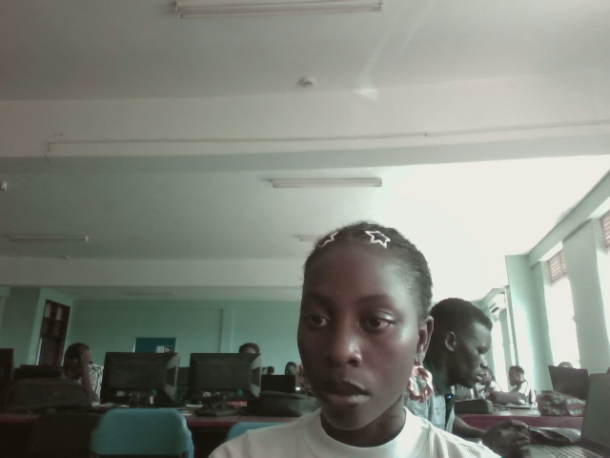
DATABASE DESIGN
Main entities used in the database:
Books
Borrow
Return
Loans
Fine and payment

Slide 8
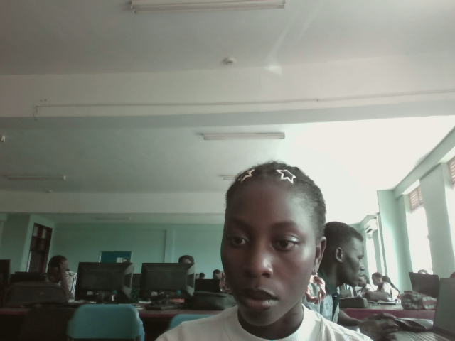
ENTITIES AND ATTRIBUTES.
Attributes describe the properties of each entity and Entities represent objects stored in the database.
Entity
Attribute
Books
Borrow
loans
returns
members
Book ID, Title, Author, Category
Borrow ID, Member ID, Book ID, Borrow Date
LoanID, BookID, Loan Date, DueDate , Return Date, Status
ReturnID , LoanID, MemberID , MemberID, Return Date , Fine Amount,
MemberID , Names, Gender, Phone Number

Slide 9
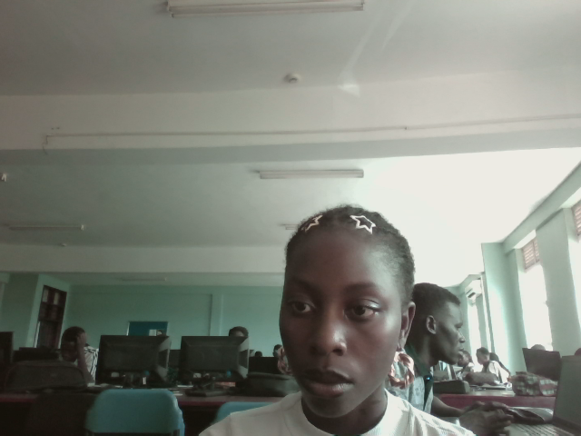
DATABASE OPERATIONS
Operations performed
Insert records
Update records
Delete records
Retrieve records
The database supports all major operations of add, edit, remove, and search for information and the SQL queries are performed using these operations

Slide 10

MYSQL TABLE CREATION
So, I typed MySQL –u root then enter and create database then database name then use database the database name then I would begin to create my tables.

Slide 11
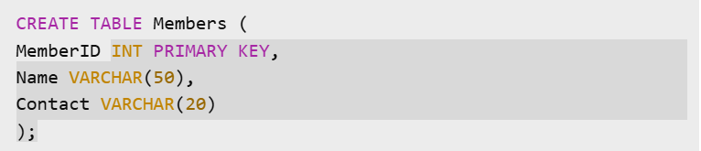
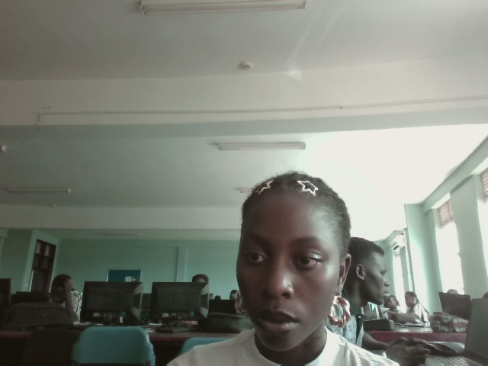
Example of the tables
SQL commands were used to create the tables.
The primary keys uniquely identifies each record
The data types were assigned to each attribute

Slide 12


Sample data entry
After creating tables, records were inserted into the database.
SQL INSERT statements were used to add sample data.

Slide 13

NORMALIZATION
Normalization was applied by separating the database into related tables such as Members, Books, and Borrow tables. Duplicate information like member names and book titles was stored only once and linked using primary and foreign keys. This reduced data redundancy and improved data consistency in the MySQL database.

Slide 14
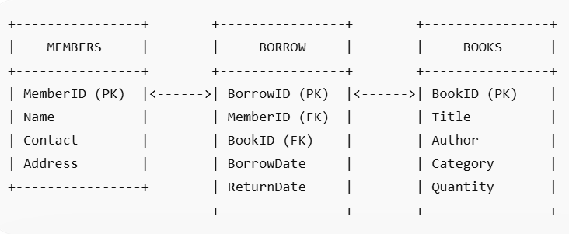
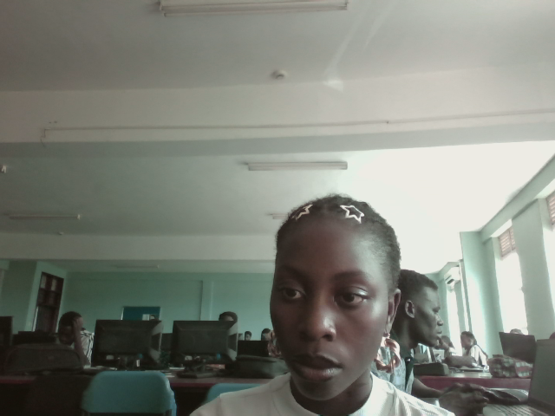
Example of the relationship diagram

Slide 15

CONCLUSION
Conclusively I was able to come up with a functioning system and achieved my ma goals which are:
Automated library circulation activities
Reduced data redundancy using normalization
Improved accuracy and efficiency
Managed borrowing and returning of books effectively
I achieved all the above using MYSQL

